Slide 1
Reproducible Research Journal Club
Storing, collaborating, accessing files, & versioning (github)
8/24/2016
Lina Gao
Contents from Reproducible Research with R and Rstudio, Chapter5
lynda.com git and github courses
https://git-scm.com/

Slide 2
Our goals/Criteria
Storing data to protect data from mishaps
Accessing data from different devices in different locations
Collaborating with other people, which means collaborators need to have access as well
Versioning for keeping track of changes and having access to previous versions

Slide 3
Tools that meet our criteria
Dropbox, Box, Onedrive
Github

Slide 4
Our goals/Criteria
Storing data to protect data from mishaps
Accessing data from different devices in different locations
Collaborating with other people, which means collaborators need to have access as well
Versioning for keeping track of changes and having access to previous versions

Slide 5
Git vs.Github
Git does the version control. It is a distributed VCS (version control system).
Github is an interface and cloud hosting service on top of the Git VCS. It also stores data remotely.

Slide 6
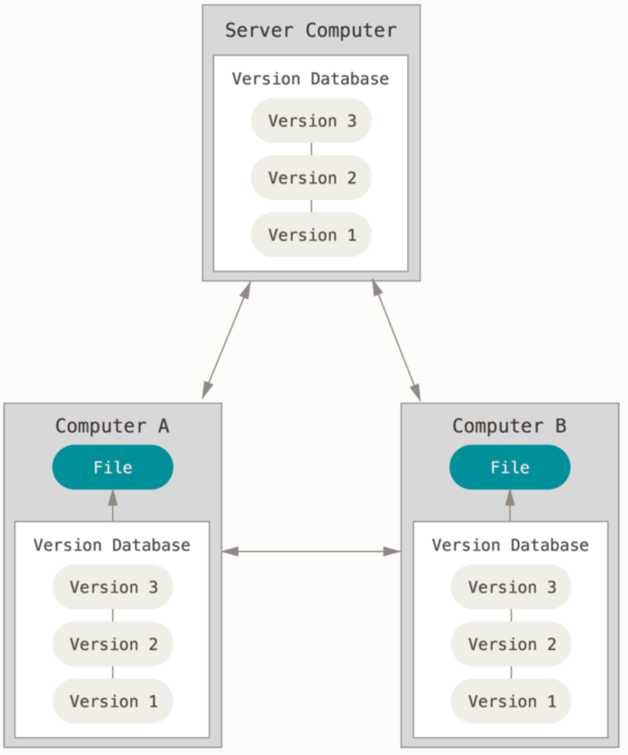
Distributed VCS
Clients fully mirror the repository. Every clone is a full backup of all the data.

Slide 7
How Git stores its data
Git stores data as a series of snapshots.
When you make a commit, Git stores a commit object which contains:
a pointer to the snapshot of the content you staged;
pointers to the commit or commits that directly came before this commit (its parent or parents);
the author’s name and email;
the message that you typed
This way, Git doesn’t need to store actual copies of all your versions, which could be huge

Slide 8
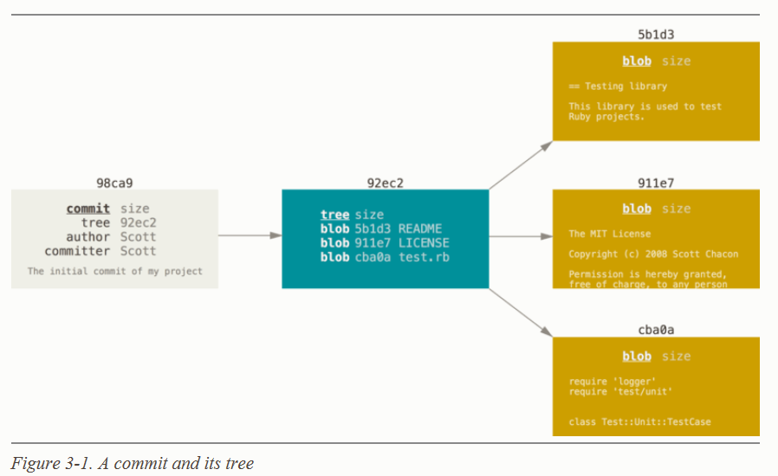
How Git stores its data
Suppose you just committed 3 files into your Git repository (repo):
README
test.rb
LICENSE
Your Git repository now contains five objects:
3 blobs for the contents of each of your three files;
1 tree that lists the contents of the directory and specifies which file names are stored as which blobs;
1 commit with the pointer to that root tree and all the commit metadata.
SHA-1 hash

Slide 9
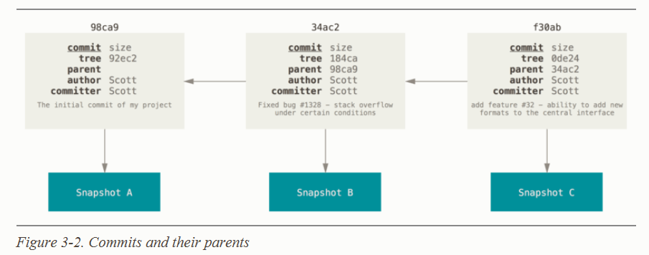
How Git stores its data
If you make some changes and commit again, the next commit stores a pointer to the commit that came immediately before it.

Slide 10
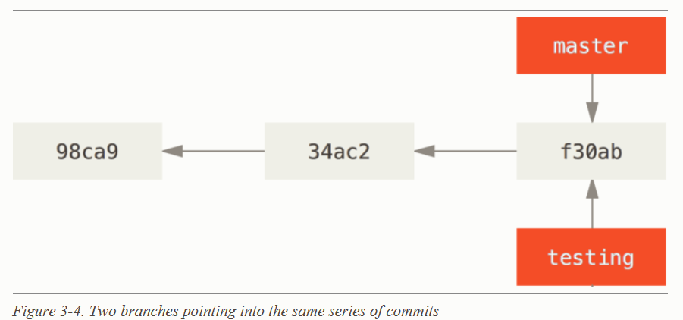
Git allows you to have branches
A branch in Git is simply a lightweight movable pointer to one of these commits.

Slide 11
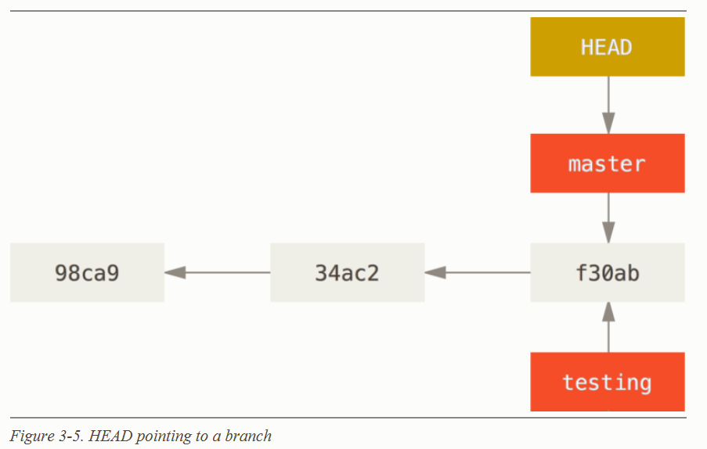
Git allows you to have branches
A branch in Git is simply a lightweight movable pointer to one of these commits.

Slide 12
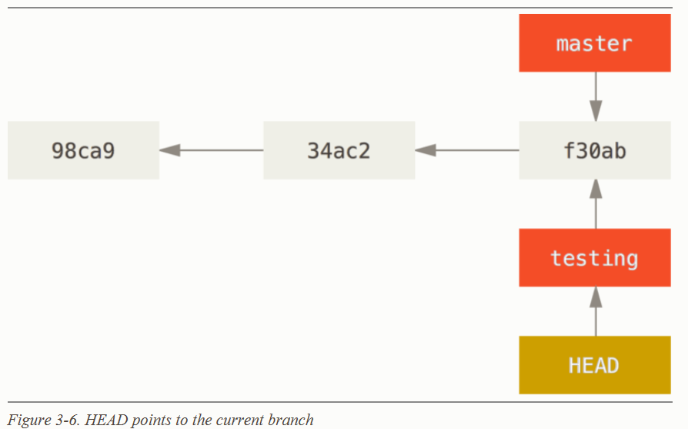
Git allows you to have branches
A branch in Git is simply a lightweight movable pointer to one of these commits.

Slide 13
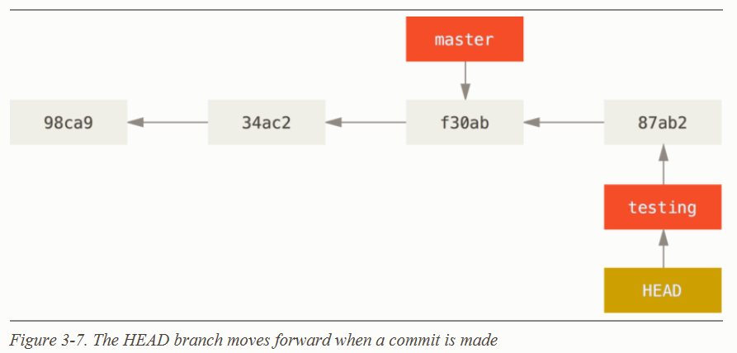
Git allows you to have branches
A branch in Git is simply a lightweight movable pointer to one of these commits.

Slide 14
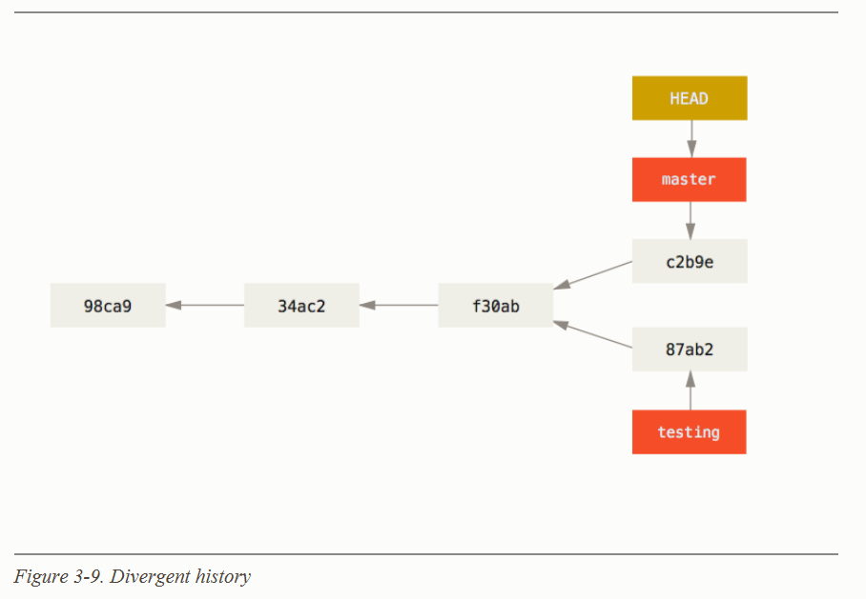
Git allows you to have branches
A branch in Git is simply a lightweight movable pointer to one of these commits.

Slide 15
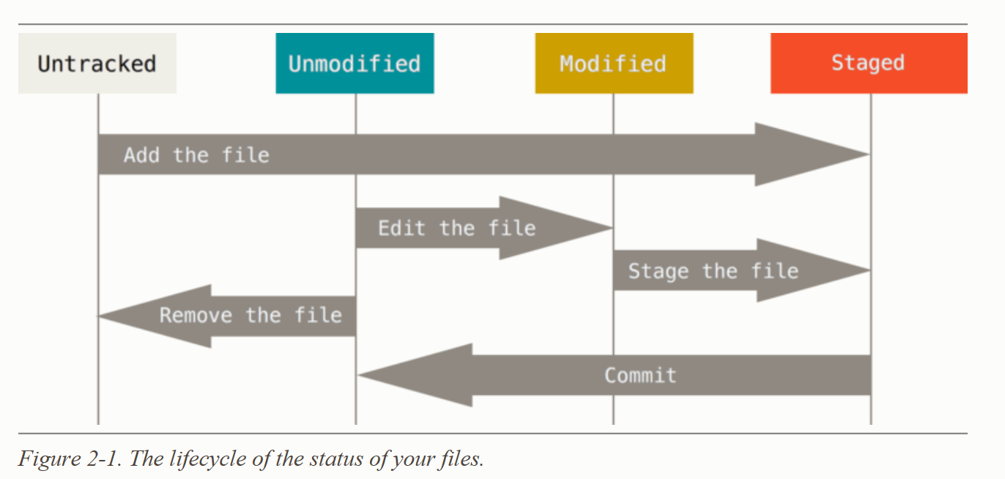
How Git tracks changes
Git only track changes (have records for changes) when you commit them!

Slide 16
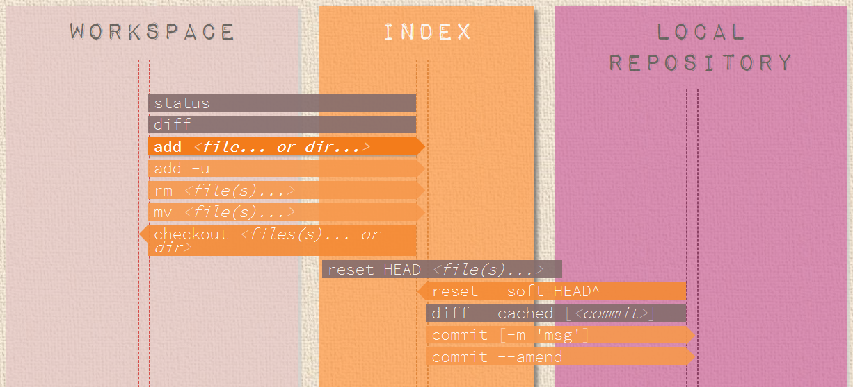
How Git tracks changes
Working environment
Staging environment
Commit

Slide 17
Resources
Git documentation: https://git-scm.com/doc
Lynda.com courses:
Up and Running with Git and GitHub
https://www.lynda.com/Git-tutorials/Up-Running-Git-GitHub/409275-2.html?srchtrk=index%3a1%0alinktypeid%3a2%0aq%3agit%0apage%3a1%0as%3arelevance%0asa%3atrue%0aproducttypeid%3a2
Git Essential Training
https://www.lynda.com/Git-tutorials/Git-Essential-Training/100222-2.html?srchtrk=index%3a1%0alinktypeid%3a2%0aq%3agit%0apage%3a1%0as%3arelevance%0asa%3atrue%0aproducttypeid%3a2
Github for web designers
https://www.lynda.com/GitHub-tutorials/GitHub-Web-Designers/162276-2.html

Slide 18
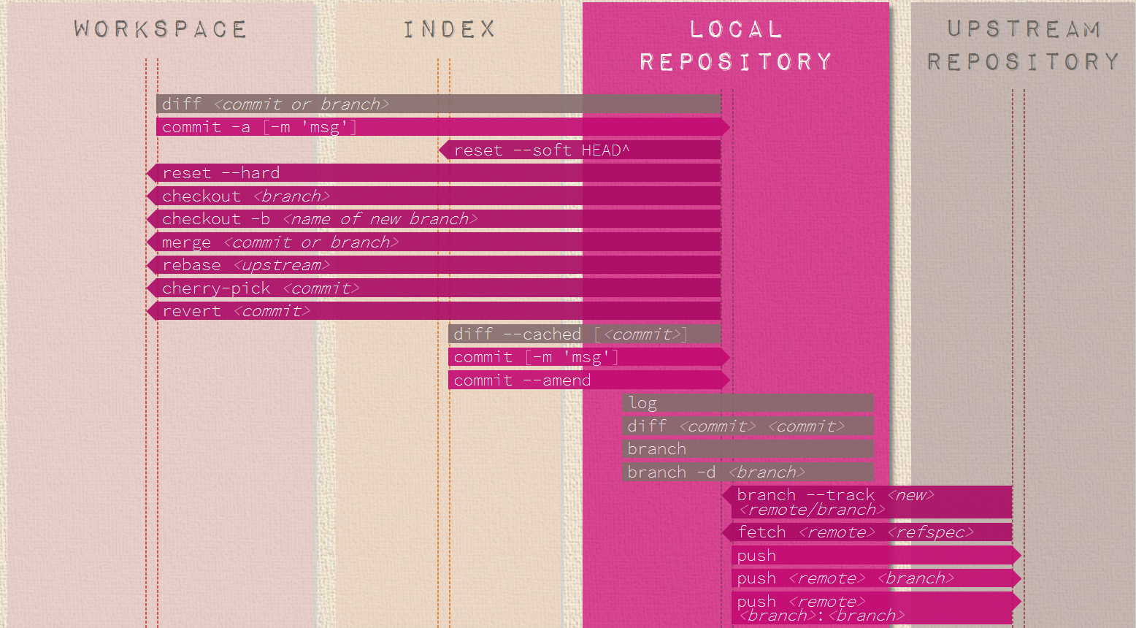
Github comes into the picture

Slide 19
Store a repo remotely on Github
Method 1
Create a new repo on Github
Push an existing local repo to this new repo on Github
Work on your local clone
Push changes
Method 2
Create a new repo on Github, or fork one from other people
Clone to your computer
Work on your local clone
Push changes

Slide 20
Collaboration on Github
Collaborators on the same repo
Go to settings/collaborators
Add collaborator’s github account
Collaborator can then clone the repo and work the project from his local computer
All collaborators have permission to update the remote repo by pushing changes to remote repo
Because different people can work on the project simultaneously, there could be conflicting changes
One person takes lead, all other send pull request to him without pushing changes, then the leader decides/executes the pushing;
Before pushing your new changes, pull from remote repo to get the most recent commit, reconcile conflicts on your local computer, then push

Slide 21
Collaboration on Github
Collaboration by forking
The repo has one (or more) owners
You want to contribute to the project
Fork the repo to your own github account
Clone to your computer and work on it
Push changes to your github repo
Send pull request to the owner, who will decide/execute merging your changes to his repo
Note:
With this collaboration mode, when you fork the repo, you forked the most recent snapshot. So when the owner updates his repo, you don’t get the updates on your remote repo. You need to establish the owner’s repo as upstream and fetch or pull changes to your repo.

Slide 22
Rstudio and Github
Downloading data from Github into R

Slide 23
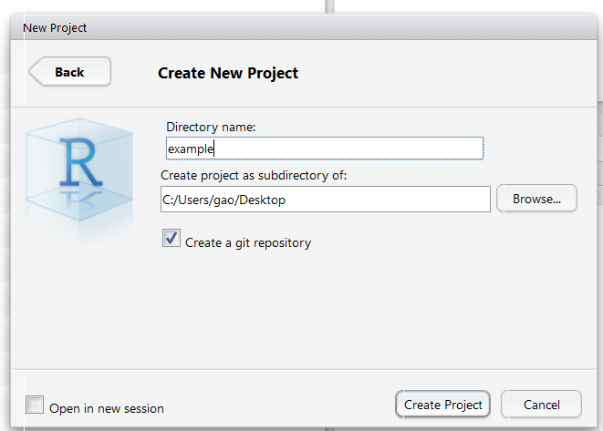
Rstudio and Github
Set up and use git in Rstudio projects
Git with a new project
New Project -> New Directory -> Empty Project
You can then use Git Bash to see this is a git repo

Slide 24
Rstudio and Github
Set up and use git in Rstudio projects
Git init exising projects
Project options -> Git/SVN -> Git
Or, git inti in Git Bash
Need to re-open the project in Rstudio in either case, otherwise git button won’t appear for you to use

Slide 25
Rstudio and Github
Set up and use git in Rstudio projects
Clone repo into a new project (Jessica showed us last week)
New Project -> Version Control -> Git -> paste repo URL

Slide 26
Rstudio and Github
Set up and use git in Rstudio projects
Add existing project repo to Github
Or, working on the project later
Git -> more -> Shell : opens something like Git Bash, then you can do all the things you have leant.
Rstudio also provides non-command line ways to use git in the git window.

